Slide 1
Game Pitch Proposal
New Brunswick Community College (NBCC)
Gaming Experience Development: Comprehensive Development Project
Winter 2022
Space-Shooters
By Arth Patel

Slide 2

Introduction
This game pitch document contains the comprehensive description of the final game project development using the skills learned throughout the program. The game is built on C++ programming language and SFML (Simple and Fast Multimedia Library) API. SFML is a cross-platform software development library designed to provide a simple application programming interface to various multimedia components in computers.

Slide 3
Game Description
The big picture of the game is to defend the spaceship from the different enemies and defend the final boss to win the game. The spaceship introduced with different types of pickups during the mission. The pickups will be not generated randomly, spaceship has to kill some enemies in order to generate some pickups. The pickups generally boost speed, upgrades the bullet type and increases health of the player spaceship. The Player have to keep their health safe (stay alive) to survive till the end.
The main quest of the game is to defend enemies and kill the final boss to win the game and exceed to the next level. The failure of doing that will bring you to the first level of the game. If a player ended having 0% of health, or killed by enemy, the result will be the same.
The main players of the space shooter will be Spaceship (player), little space shuttles (enemy), final boss

Slide 4
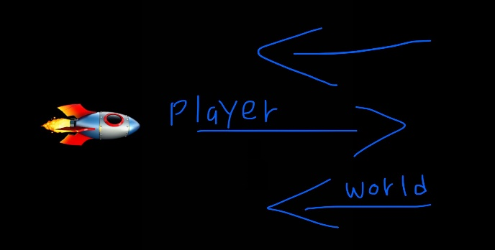
Sketch of the world
The space-shooter game behavior is side-scroller. The screen will follow player spaceship as it moves right side.
So, the action is from left to right.
For example,

Slide 5
Controls
There are many certain key controls for controlling the player spaceship and game behavior.
W | UP – upside of the map
S | DOWN – downside of the map
D | Right – right side of the map (in side-scroll game case, it refers to forward.)
A | LEFT – left side of the map (in side-scroll game case, it refers to backward)

Slide 6
summary
The space-shooter game is a 2D shooting game in space and the main story is the player spaceship fights with certain aliens, enemies, and boss to reach its safe home back.
The space-shooters game is likely to be resulted as more fun in general. Although, there is little graphics and animations in the game, it is effectively differentiating from other recent space-based game. Moreover, anyone can play this game if they are above 10+ years. This game is user friendly and easy to play. Space-shooters can be played on worlds most used operating system – windows. The game will surely fulfil user’s expectations such as short-term fun during work or anything else.
The game will have updates at certain amount of time for optimization and new map, new character, new enemies, more animations, graphics and many more. The game will be more and more fun gradually.

